Slide 1
FIT2095
e-Business software technologies
Week 9 - Workshop Quiz
3 Questions

Slide 2
Question 1 (5+5+12=22) marks
In terms of functionality, what is the difference between Components and Services?
What should you do make a service accessible application wide?
What is Observable?
Why do HTTP methods (get, put, post,delete) return observable?
What should we do to execute them?

Slide 3
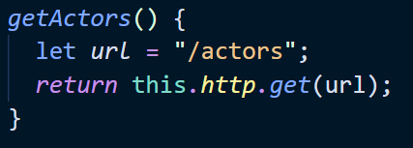
Question 2 (15 marks)
Assume you have this function is implemented in a service named ‘DBService’:
Develop a function in a component named ‘imdb’ that invokes ‘getActors’ and logs out the returned object.

Slide 4

Question 3 (15)
Write the simplest HTML code that produces the following:
Notes:
The page has three sections (i.e. three div elements)
For the switching to work, the value of section on/off should be =‘on’
Section number {1,2,3}

